Slide 1
Crop Classification and Yield Prediction using image processing
Rochak shrivastav 20BCE1814
Biradar Shailesh 20BCE1845
MD Ayan zafar 20bce1851
Aakash goyal 20bce1617

Slide 2
Introduction
The "Crop Yield Prediction using Drone" project leverages modern drone technology to revolutionize traditional farming.
Equipped with high-resolution cameras, machine learning models, and environmental sensors, our drone aims to optimize crop management and contribute to sustainable agricultural practices.

Slide 3
Motivation
Traditional farming methods face challenges such as labor-intensive processes, delayed responses to threats, and suboptimal resource utilization.
This project is motivated by the need to address these issues through the integration of drones and artificial intelligence.

Slide 4
Problem Statement
Traditional crop identification methods are time-consuming and error-prone. Our project focuses on using drone-captured images and machine learning algorithms to accurately classify crops, including rice, corn, bajra, and sugarcane.
Farmers struggle to determine optimal water and pesticide usage for different crops, leading to inefficiencies. Our solution involves predicting ideal resource allocation based on crop types and farming areas, enhancing overall resource optimization Using yield prediction.
Dynamically determine fire in farms using image processing
Aerial seeding to reduce labor and save time.

Slide 5
Fire Detection
Utilization of MobileNet:Incorporate a pretrained convolutional neural network (CNN), MobileNet, in the model for fire detection in images.
Transfer Learning Approach: Implement transfer learning to adapt MobileNet to the fire detection task without retraining from scratch.
Architecture Modification: Modify the MobileNet architecture to configure the model for binary classification options, distinguishing between fire and nonfire scenarios.
Freezing Layers: Freeze most layers to retain pretrained weights, allowing only newly added layers to be fine-tuned for the specific dataset.

Slide 6
Fire Detection
Weight Adjustment During Training: Models adjust their weights during the training process, learning from marked images of fires and other scenarios to improve detection accuracy.
Binary Classification: Configure the model to classify images into two categories – fire or nonfire – based on the established patterns learned during training.
Loss Function and Optimizer: Guide the training process with a consolidated crossentropy loss function and an Adam optimizer for efficient and effective model learning.
Detection Capability: Emphasize that after training, the model will be capable of detecting the presence of fire in new images, leveraging the learned patterns from the training dataset.

Slide 7
Crop Identification
Utilization of VGG16 model for crop classification in an unlabeled dataset.
VGG16's role in performing image classification tasks.
Model architecture involving convolutional layers for feature extraction, pooling layers for down-sampling, and fully connected layers for prediction.
Training process using unlabeled datasets to optimize parameters via backpropagation and minimize the loss function.
Inference phase mechanics, where input images undergo feature extraction and prediction generation by convolutional and fully connected layers.

Slide 8
Crop Yield Prediction
Combine multiple datasets to get the required dataframe with required number of attributes
Normalize input features using MinMax scaling algorithm.
Ensure uniform reflection of features in the model to prevent disproportionate influence during the learning process.
Split the dataset into training sets (75%) and testing sets (25%).
Facilitate model evaluation by assessing predicted performance on a separate testing set.

Slide 9
Crop Yield Prediction
Utilize RandomForestRegressor from Scikit-learn as the predictive model.
Configure the model with 501 decision trees for enhanced robustness and accuracy.
Train the model to learn patterns and relationships between features and crop yields.
Generate predictions for the test set after the training process.
Evaluate the model's performance by comparing predicted crop yield values to actual values in the test set.

Slide 10
Aerial Seeding
Integration of drone, Arduino, and servo motor for autonomous seed dispersal.
30-second activation timer for accurate drone positioning. Control transition to Arduino-connected servo motor after timer completion.
Servo motor manages seed container opening and closing.
Predefined sequence for releasing seeds at 5-second intervals.
Autonomous cycle repeats until system turn-off or predetermined dispersal cycles completion.
Battery Life of 20 to 30 minutes.

Slide 11
Aerial Seeding
Integration of drone, Arduino, and servo motor for autonomous seed dispersal.
30-second activation timer for accurate drone positioning. Control transition to Arduino-connected servo motor after timer completion.
Servo motor manages seed container opening and closing.
Predefined sequence for releasing seeds at 5-second intervals.
Autonomous cycle repeats until system turn-off or predetermined dispersal cycles completion.
Battery Life of 20 to 30 minutes.

Slide 12
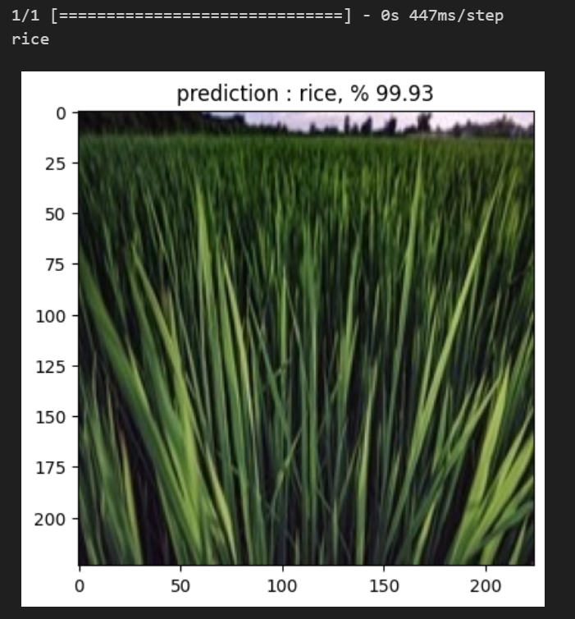
Implementation of Crop Identification

Slide 13
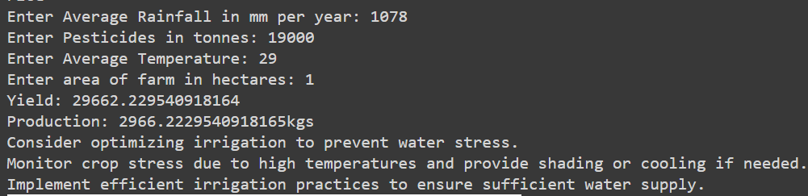
Implementation of Crop Yield Prediction

Slide 14
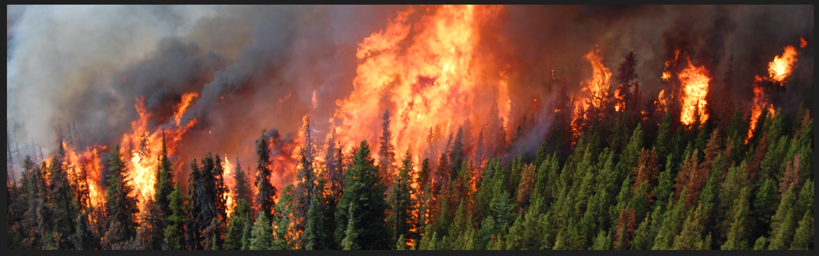
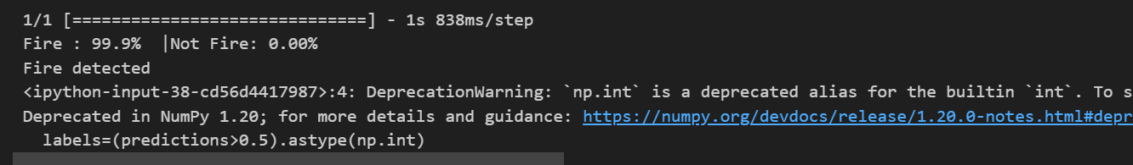
Implementation of Fire Detection

Slide 15
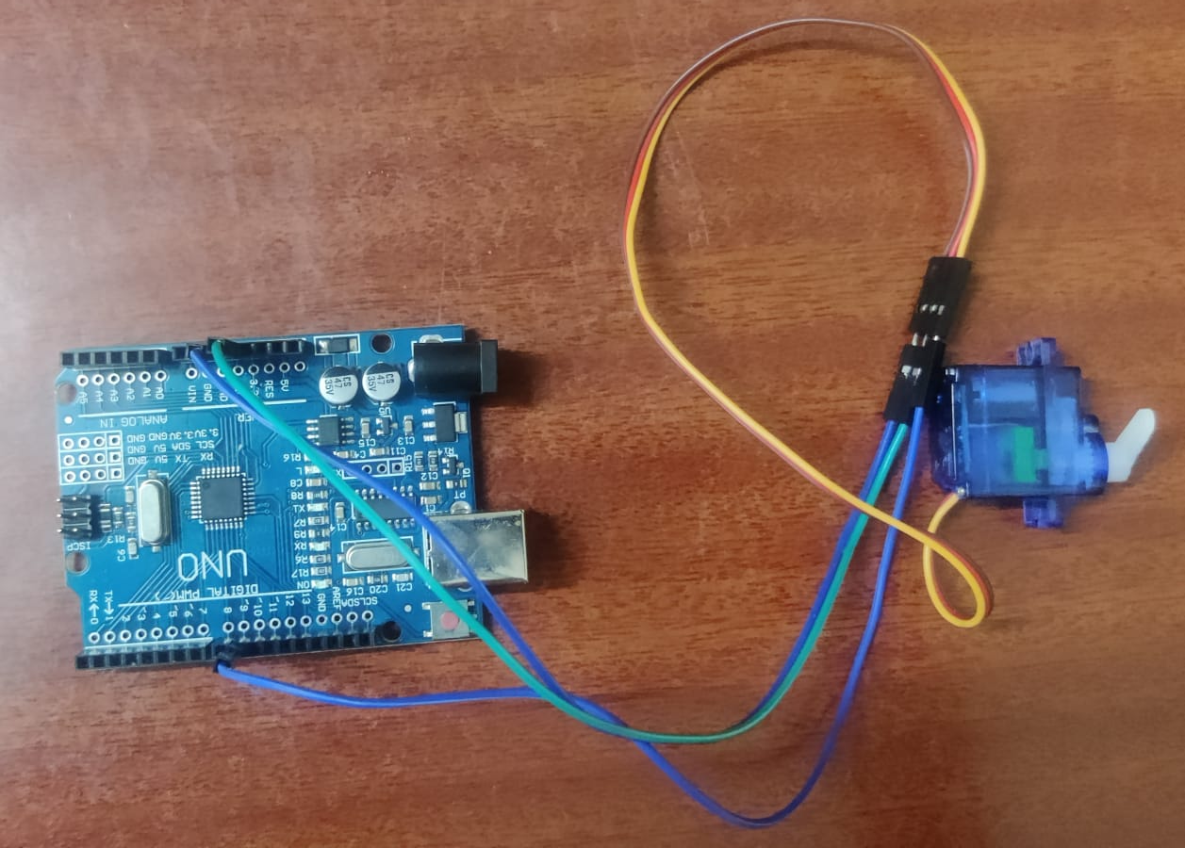
Implementation of Aerial Seeding

Slide 16
Result
Crop Yield prediction has been successfully implemented with function to give suggestion based on provided data with an accuracy of 96.5%
Crop identification system has been implemented with an accuracy of 91.9%
Fire Detection system has been implemented with an accuracy of 95%
Aerial Seeding system has been successfully achieved with an overall runtime of 20 to 30 minutes.

Slide 17
Thank you

